Slide 1
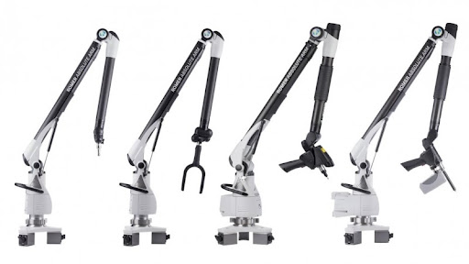
Term 4 Week 1 – Progress Meeting
General Update
Electromagnet is almost finished in production
  Pressure tabs were incorrectly welded
  Expected completion is Monday
Safety Report has been approved
  Was placed in Mechatronics labs 3rd floor
  Was given locker to place electromagnet when not present.
  Switching circuit and software development to be completed this weeked
Takealot Blunder
  Initially, order was placed at the wrong pickup point
  Error was corrected, the new delivery date is Tuesday 22/09
Continue documentation in report

